Slide 1



Hibernate One-to-One Bi-Directional

Slide 2


One-to-One Mapping
We currently have a uni-directional mapping
Instructor Detail
Instructor
www.luv2code.com

Slide 3


New Use Case
If we load an InstructorDetail
Then we’d like to get the associated Instructor
•
Can’t do this with current uni-directional relationship :-(
Instructor Detail
Instructor
www.luv2code.com

Slide 4


Bi-Directional
Bi-Directional relationship is the solution
•
We can start with InstructorDetail and make it back to the Instructor
Instructor Detail
Instructor
www.luv2code.com

Slide 5
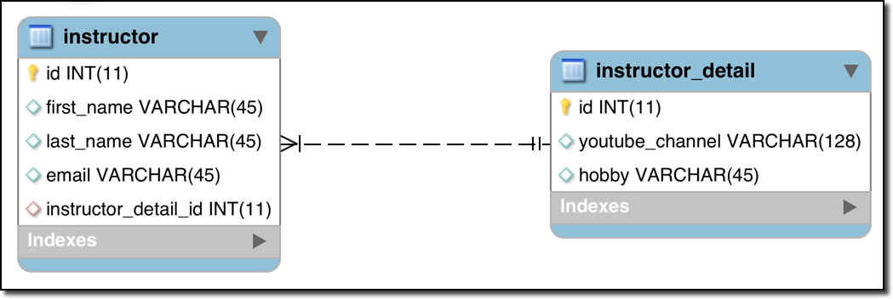
Bi-Directional - The Good News
•
To use Bi-Directional, we can keep the existing database schema
No changes required to database
•
Simply update the Java code
www.luv2code.com

Slide 6
Development Process: One-to-One (Bi-Directional)
Make updates to InstructorDetail class:
Add new field to reference Instructor
Add getter/setter methods for Instructor
Add @OneToOne annotation
Create Main App
Step-By-Step
www.luv2code.com

Slide 7

Step 1.1: Add new field to reference Instructor
@Entity @Table(name="instructor_detail") public class InstructorDetail {
…
private Instructor instructor;
…
}
www.luv2code.com

Slide 8
Step 1.2: Add getter/setter methods Instructor
@Entity @Table(name="instructor_detail") public class InstructorDetail {
…
private Instructor instructor; public Instructor getInstructor() {
return instructor;
}
public void setInstructor(Instructor instructor) { this.instructor = instructor;
}
…
}
www.luv2code.com

Slide 9
Step 1.3: Add @OneToOne annotation
@Entity @Table(name="instructor_detail") public class InstructorDetail {
…
@OneToOne(mappedBy="instructorDetail") private Instructor instructor;
public Instructor getInstructor() { return instructor;
}
public void setInstructor(Instructor instructor) { this.instructor = instructor;
}
…
}
Refers to “instructorDetail” property in “Instructor” class
www.luv2code.com

Slide 10


More on mappedBy
public class InstructorDetail {
…
@OneToOne(mappedBy="instructorDetail") private Instructor instructor;
•
mappedBy tells Hibernate
•
Look at the instructorDetail property in the Instructor class
•
Use information from the Instructor class @JoinColumn
•
To help find associated instructor
public class Instructor {
…
@OneToOne(cascade=CascadeType.ALL) @JoinColumn(name="instructor_detail_id") private InstructorDetail instructorDetail;
www.luv2code.com

Slide 11
Add support for Cascading
Cascade all operations
@Entity @Table(name="instructor_detail") public class InstructorDetail {
…
to the associated Instructor
@OneToOne(mappedBy="instructorDetail", cascade=CascadeType.ALL) private Instructor instructor;
public Instructor getInstructor() { return instructor;
}
public void setInstructor(Instructor instructor) { this.instructor = instructor;
}
…
}
www.luv2code.com

Slide 12

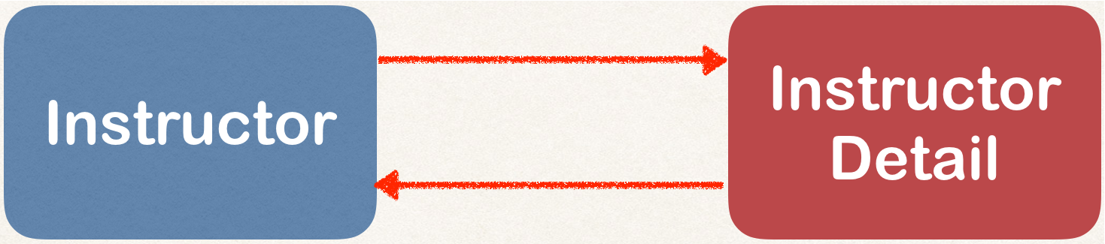

Step 2: Create Main App
public static void main(String[] args) {
…
// get the instructor detail object
int theId = 1;
InstructorDetail tempInstructorDetail = session.get(InstructorDetail.class, theId);
// print detail
System.out.println("tempInstructorDetail: " + tempInstructorDetail);
// print the associated instructor
System.out.println("the associated instructor: "
+ tempInstructorDetail.getInstructor());
…
}
www.luv2code.com

